Slide 1

POWERPOINT TITLE
Speaker Name,
Title
Facilities & Services

Slide 2
Overview
Section
Section
Section
Section
Section
Facilities & Services
Trust · Respect · Accountability · Integrity · Teamwork · Safety · Perseverance

Slide 3

Speaker Introduction
Facilities & Services
Trust · Respect · Accountability · Integrity · Teamwork · Safety · Perseverance

Slide 4

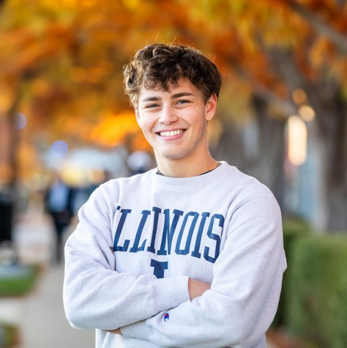
Today’s Speakers
Facilities & Services
Trust · Respect · Accountability · Integrity · Teamwork · Safety · Perseverance

Slide 5
Title and Content (1)
Section
Facilities & Services
Trust · Respect · Accountability · Integrity · Teamwork · Safety · Perseverance

Slide 6
Title and Content (2)
Section
Facilities & Services
Trust · Respect · Accountability · Integrity · Teamwork · Safety · Perseverance

Slide 7
Title and Content (3)
Section
Facilities & Services
Trust · Respect · Accountability · Integrity · Teamwork · Safety · Perseverance

Slide 8
Title and 2 Columns
Section
Facilities & Services
Trust · Respect · Accountability · Integrity · Teamwork · Safety · Perseverance

Slide 9
Section Divider (1)
Section
Facilities & Services
Trust · Respect · Accountability · Integrity · Teamwork · Safety · Perseverance

Slide 10
“Quote”
-Last name First name, Title
Facilities & Services
Trust · Respect · Accountability · Integrity · Teamwork · Safety · Perseverance

Slide 11
Timeline with Months
Section
GOAL | DELIVERABLES | JAN | FEB | MAR | APR | MAY | JUN | JUL | AUG | SEP | OCT | NOV | DEC
Venus is very hot | Venus has a beautiful name and is the second planet from the Sun
Earth has life | Earth is the third planet from the Sun and harbors life
Mars is very cold | Despite being red, Mars is actually a cold place
Jupiter is huge | Jupiter is the biggest planet in the Solar System
Saturn has rings | Saturn is a gas giant and has several rings
Mercury is small | Mercury is the closest planet to the Sun and the smallest one
Facilities & Services
Trust · Respect · Accountability · Integrity · Teamwork · Safety · Perseverance

Slide 12
Timeline with Sections
Section
Section 1
Section 2
Section 3
Section 4
Facilities & Services
Trust · Respect · Accountability · Integrity · Teamwork · Safety · Perseverance

Slide 13
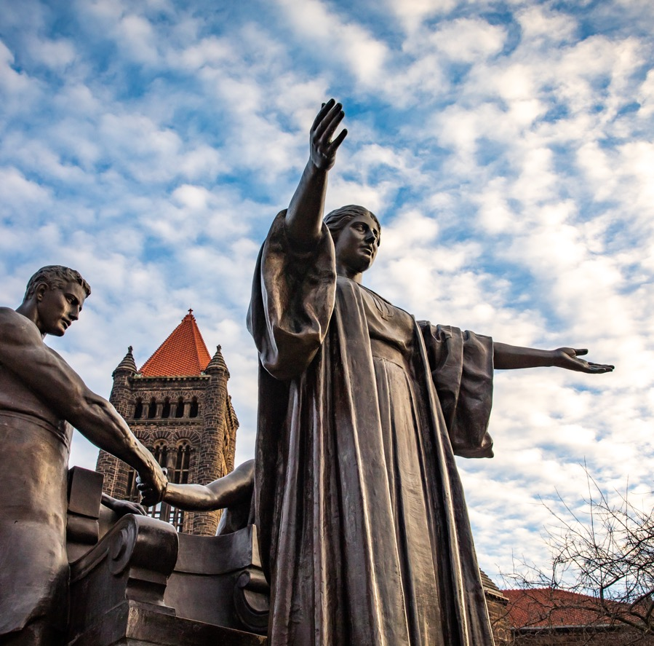
Photo Right
Section
Facilities & Services
Trust · Respect · Accountability · Integrity · Teamwork · Safety · Perseverance

Slide 14
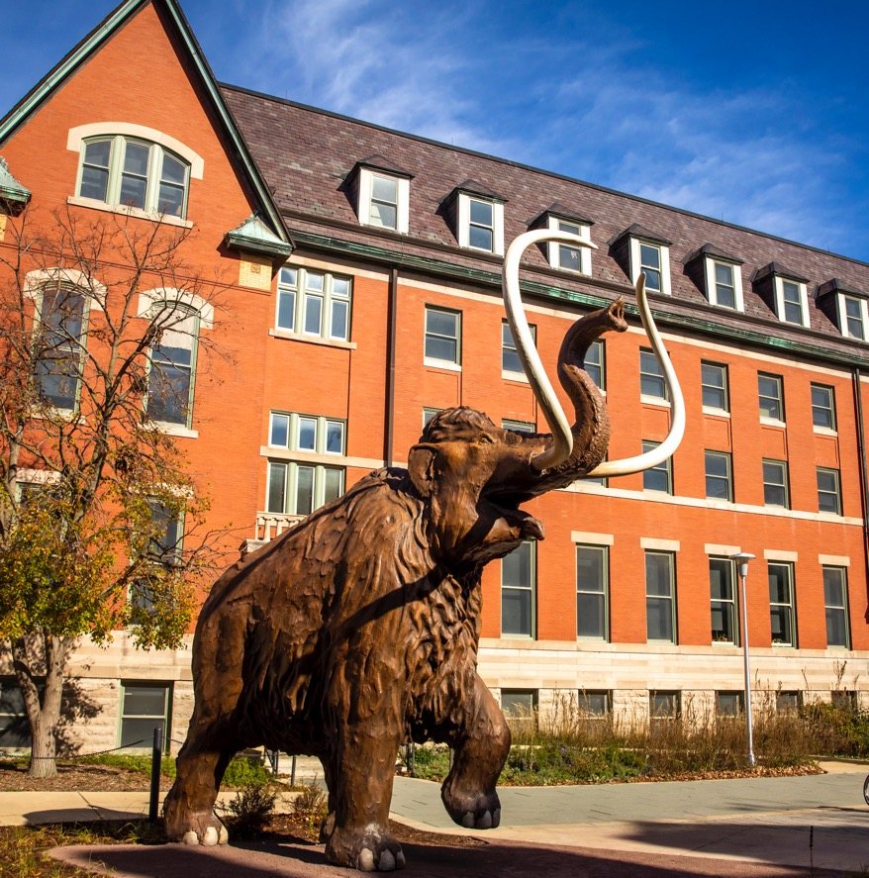

Photo Left
Section
Facilities & Services
Trust · Respect · Accountability · Integrity · Teamwork · Safety · Perseverance

Slide 15
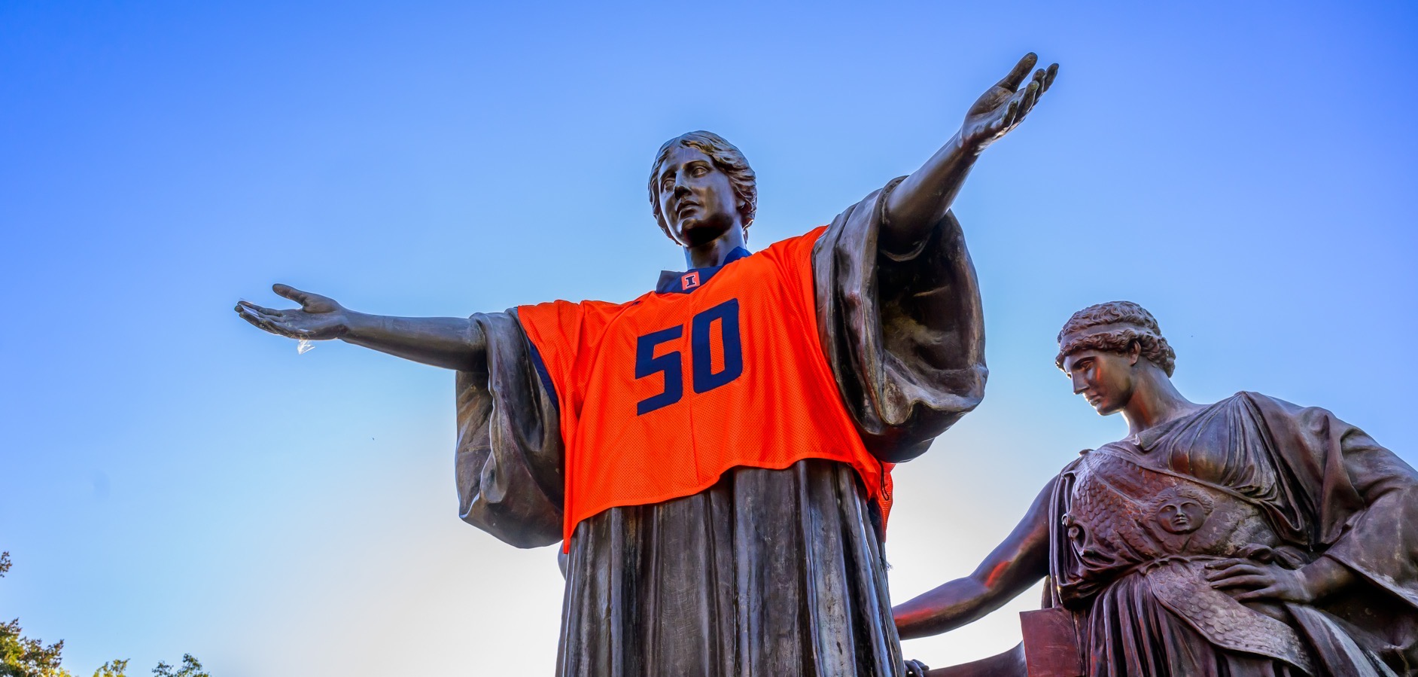
Photo (1)
Facilities & Services
Trust · Respect · Accountability · Integrity · Teamwork · Safety · Perseverance

Slide 16
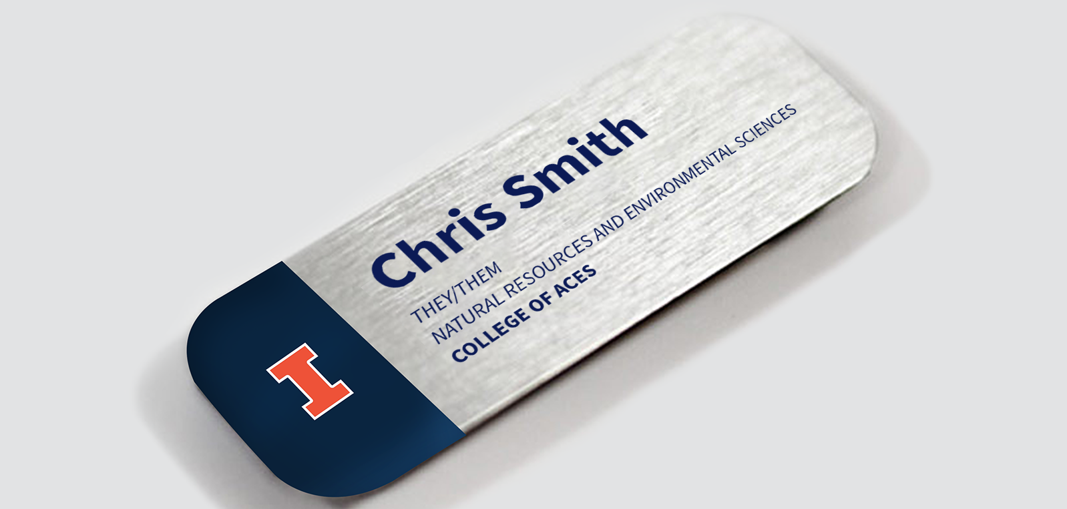
Photo (2)
Trust · Respect · Accountability · Integrity · Teamwork · Safety · Perseverance

Slide 17

Web Video
Facilities & Services
Notes:
To screen record on a mac: Shift + Command + 5
For this example, I selected “Record Selected Portion”

Slide 18
Questions?
THANK YOU!
Facilities & Services
Trust · Respect · Accountability · Integrity · Teamwork · Safety · Perseverance

Slide 19
Thank You
THANK YOU!
Please contact branding@illinois.edu with any questions.
Facilities & Services
Trust · Respect · Accountability · Integrity · Teamwork · Safety · Perseverance

Slide 20




Assets

